Slide 1
Keep C.A.L.M
And Caption On
Virginia Tech is committed to equal opportunity in employment and education for individuals with disabilities and complies with the Americans with Disabilities Act, as amended, and Section 504 of the Rehabilitation Act of 1973. The C.A.L.M. campaign broadly promotes accessibility and supports compliance with VT Policy 7215 thereby creating a campus community with “equal access opportunity to electronic and information technology (EIT).” This is accomplished through adherence to Section 508 of the Rehabilitation Act and conformance with Web Content Accessibility Guidelines 2.0 AA (WCAG).

Slide 2
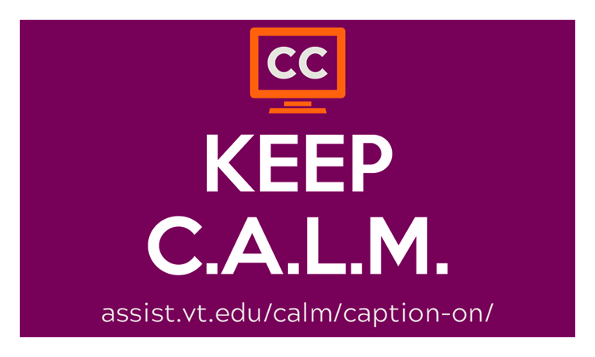
Captions make video available to ALL
Closed Captions serve many purposes:
  Watching video in sound sensitive environments
  Supporting additional comprehension
  Accessibility for deaf, hard of hearing, and multilingual audience members
  Improving search engine optimization
  For More: http://bit.ly/UseCaptions

Slide 3
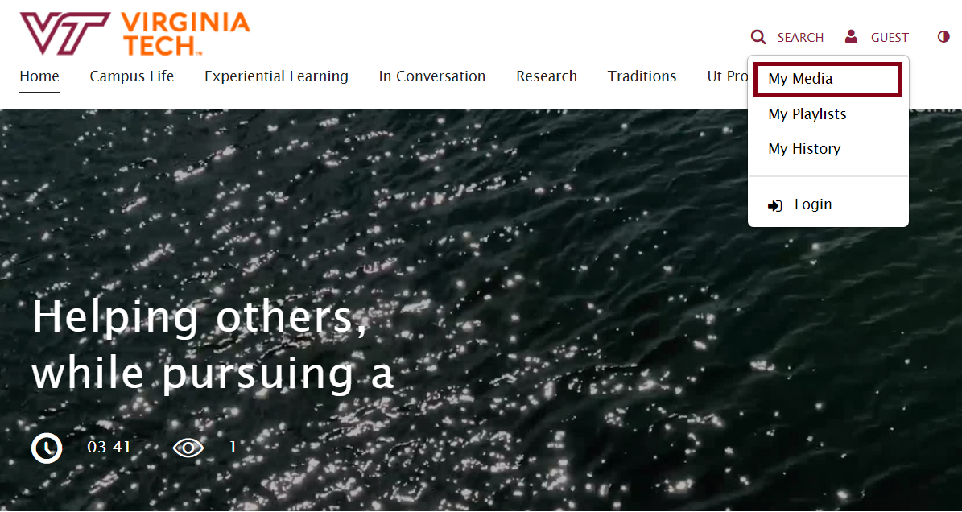
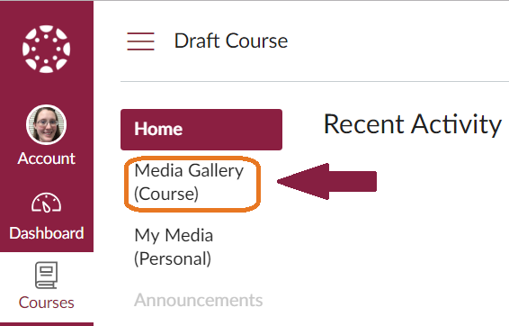
How do I get started?
Choose Captioned Content
Create Captioned Content using Kaltura
  Video.vt.edu
  Canvas.vt.edu (My Media)
For More: http://bit.ly/OrderCaptions

Slide 4
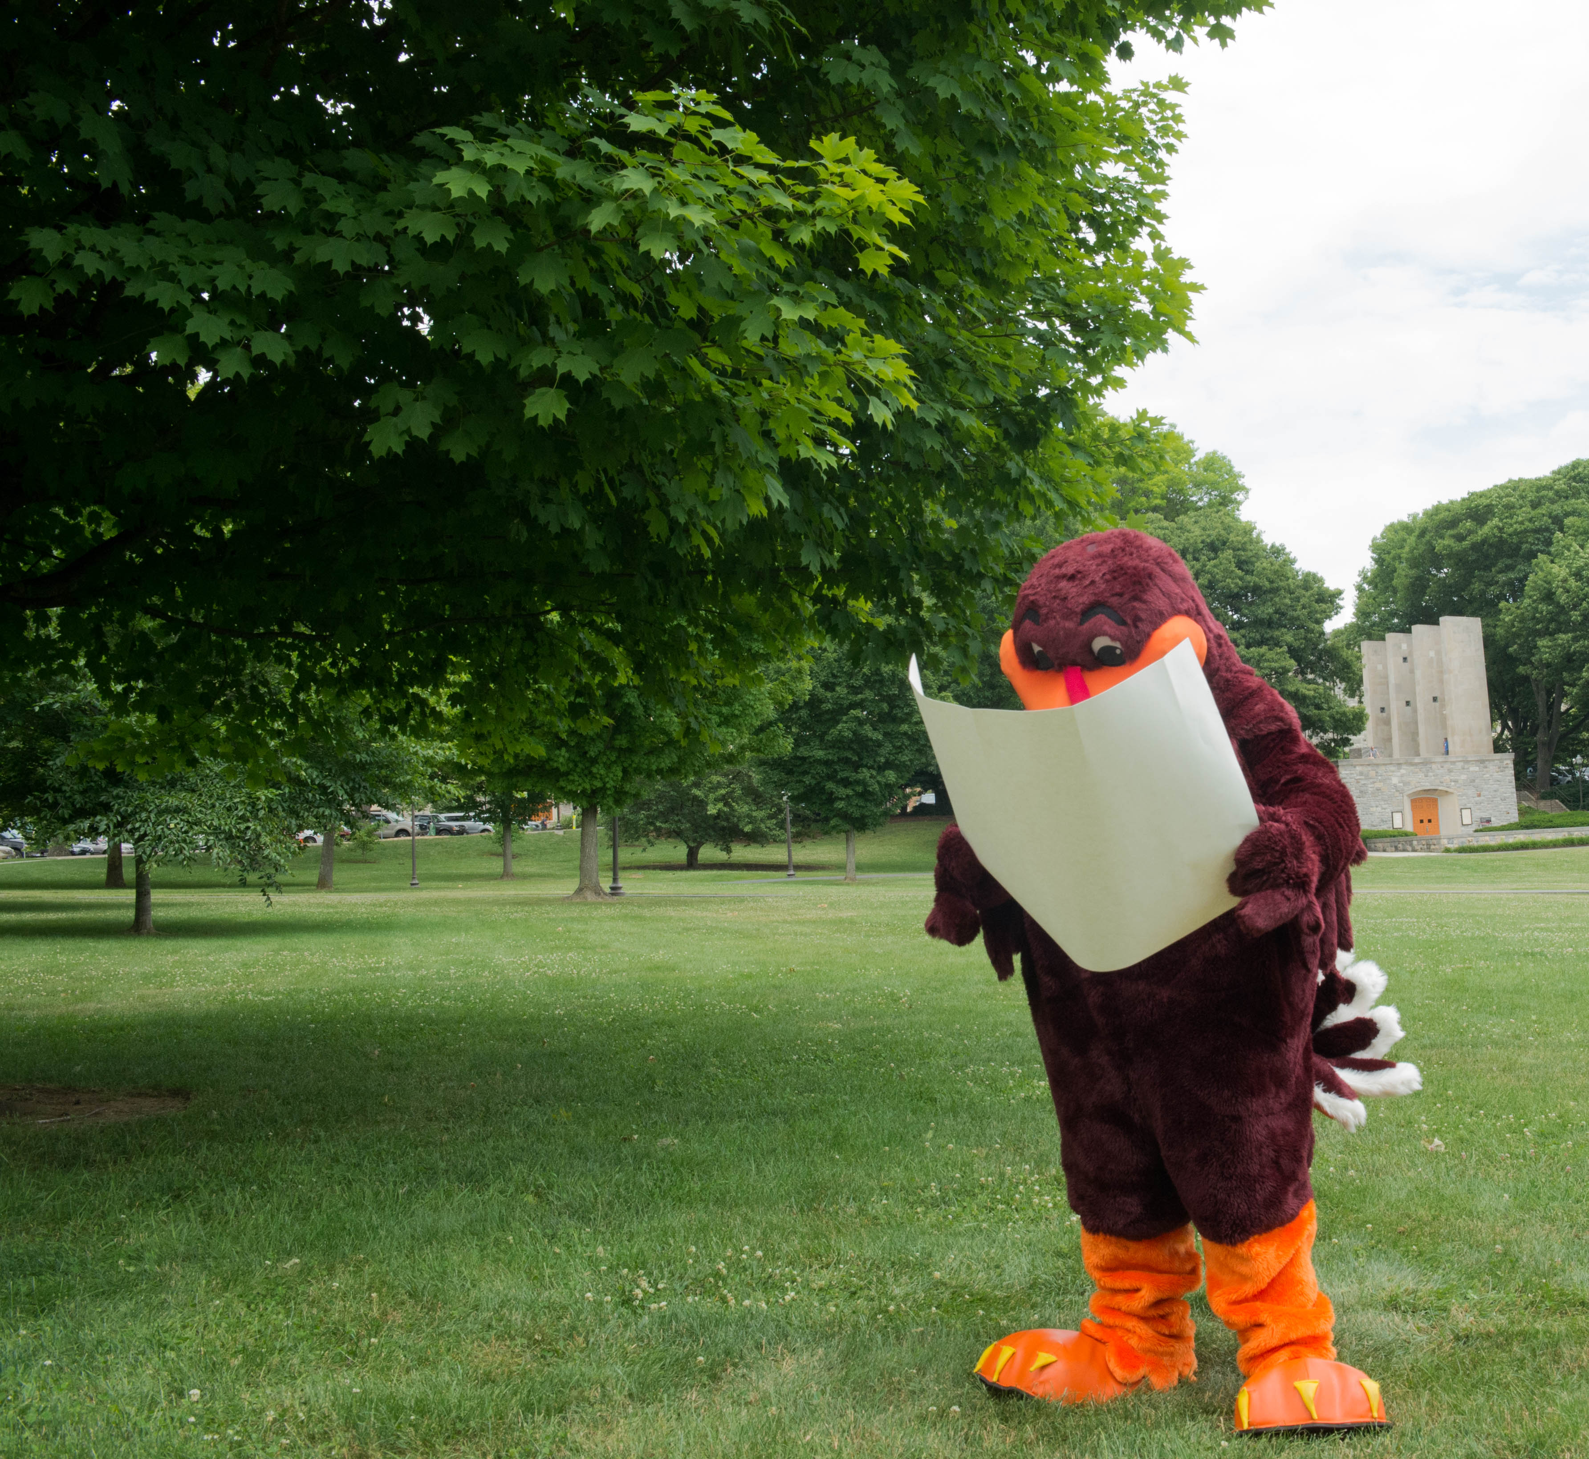
Captioning Must Haves
Timings synchronized to speaker
Identify all speakers
Identify all non-speech audio [ ]
Display time 2 to 5 sec
32 characters per line (48 max)
No more than 2 lines per caption
Avoid line breaks in phrases and descriptions
For More: www.captioningkey.org
These are just the basics, for more details always go back to the manual
Notes:
Here is my summary of the Captioning Must Haves. Essentially, without following these 6 rules the captions may not be useable.
Remember however that these are just the basics, it is always good to go back to the Captioning Key by DCMP and make sure that there are no special situations that need to be considered.

